Slide 1

Resume Extraction Project EDA
Alexis Collier
10/08/2023

Slide 2

Executive Summary Problem Statement Approach
Agenda
EDA
EDA Summary and Recommendations Model Recommendations

Slide 3
Executive Summary:
The Client:
HR departements.
Data Set:
A JSON file containing 200 resumes.
Objective:
Providing meaningful insights through analyzing the data provided to help the client’s HR department enhance their
performance.
Analysis plan:
-Graduation year analysis.
-Candidates location analysis.
-Companies candidates worked at analysis.
-Candidates’ degrees and universities studied at analysis.
Recommendation:
I recommend that the HR department takes more care of the job description and the requirements provided to have a
more accurate candidates’ resumes.

Slide 4

Problem Statement:
Problem:
Resumes contain excess information irrelevant to the HR/authority, and they have to process the resumes to shortlist the promising candidates manually. This EDA is dedicated to them to help them enhance their performance.

Slide 5

Approach:
Prescriptive analysis is the frontier of data analysis, combining the insight from all previous analyses to determine the course of action to take in a current problem or decision. And that is precisely why it was my choice for this study case.

Slide 6
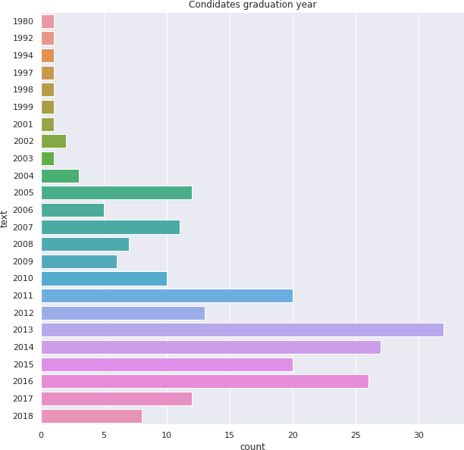
EDA:
Graduation Year Analysis:
We can see that most of the candidates
graduated after 2005.
16% of the candidates graduated in 2013 only, and 50% of them graduated between 2013 and 2016.
No candidates graduated after 2018.

Slide 7
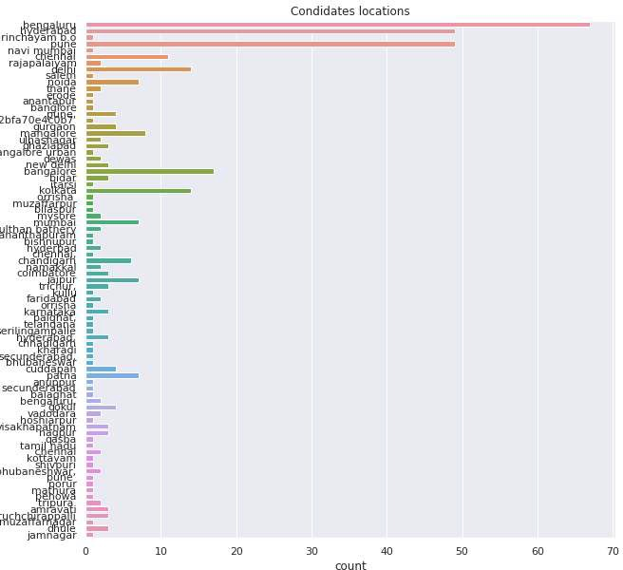
Candidates' location analysis:
Most candidates are in Bengaluru (67 out of 200), Hyderabad, and Pune (49 in each).

Slide 8
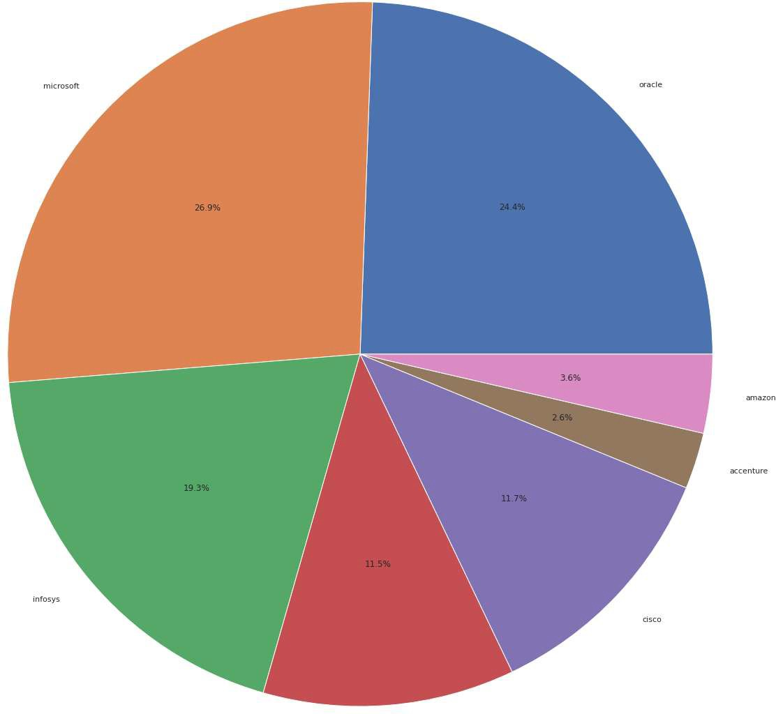
Companies' candidates worked at analysis:
As for the ‘Companies worked at’ data frame, the following chart shows that Oracle, Microsoft, SAP, Amazon, Cisco, NIIT, and Infosys are the ones with the most significant numbers of candidates having worked at them in the past.
At least 155 out of 200 (26.9%, as seen through this chart below) candidates worked at Microsoft before, and 142 out of 200(24.4%) worked at Oracle.

Slide 9
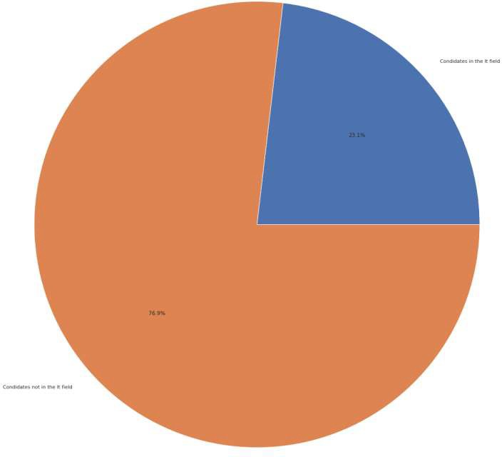
Candidates' degrees analysis:
Analyzing the “Degree “data frame showed me that only 23.1% of the candidates for this job are in IT, while the rest have different fields of study, such as business chemistry, electronics, etc.

Slide 10
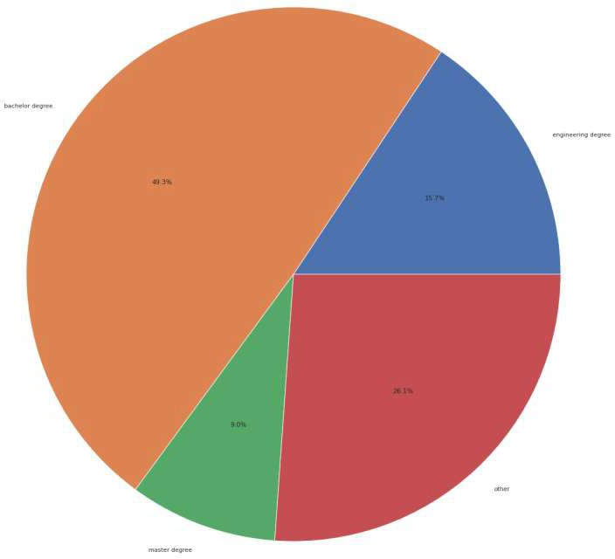
49.3% of the candidates have a bachelor’s degree.
15.7% of them are engineers.
9% of candidates have a master’s degree.

Slide 11

Universities candidates studied at analysis:
Analyzing the universities the candidates studied at, I discovered that almost everyone attended a different college.

Slide 12

EDA Summary and Recommendations:
- The EDA performed on our data has shown that the candidates who have applied are pretty different; they don’t share the same field of study or degrees. They went to other colleges and didn’t have the same skills.
- Depending on these insights, the client’s HR department can request the elimination of some candidates’ categories
Depending on the job profile needed (for example, the client needs candidates with engineering degrees)
- Also, this EDA has shown that those who applied for this job are entirely different, especially when talking about the fields of study; I recommend that the HR department takes more care of the job description and the requirements provided to have more accurate candidates’ resumes.

Slide 13
Model Recommendations:
Depending on the data we have, our business and data science objectives, I suggest the following models to work with to build the resume extraction app:
BERT:
Bidirectional Encoder Representations from Transformers (BERT) is a transformer-based machine-learning technique for
natural language processing (NLP) pre-training developed by Google.
BI-LSTM:
A Bidirectional LSTM is a sequence processing model that consists of two LSTMs: one taking the input in a forward direction and the other in a backward direction.

Slide 14
Thank You

